Slide 1
Tax Increment Finance Districts
A Quick Review

Slide 2
What is a TIF?
A TIF provides that new valuation or a portion thereof from all new development in a set area may be captured (set aside) to undertake improvements in that area or for related offsite infrastructure.
TIF rules are governed by Maine statute.
A TIF can be in place for up to 30 years and must be approved by the state.
A TIF must be based on a development plan such as a downtown redevelopment plan.
The new valuation in a TIF area is not included in the municipality’ s state valuation.

Slide 3
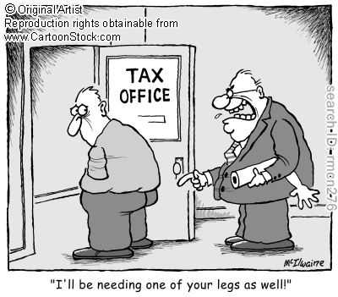
Assumption $4.0 million in new value
Would provide $67,200 in new taxes each year based on FY 2015 tax rate
Would provide $672,000 over ten years assuming the same tax rate
Because higher state valuation reduces state school subsidy, reduces revenue sharing and increases the share of the county tax, sheltering of state valuation through a TIF enables 100% of the new taxes to stay in Cape Elizabeth. Without a TIF, estimates indicate that 30% to 70% of the added tax revenue is taken by the county tax and by subtraction of state funding.
Therefore, in a TIF with $4.0 million in new value, the 30% to 70% range provides that of the $67,200 in new taxes each year, between $20,160 to $47,040 would be absorbed by state funding reductions and higher county taxes. This is a range of $201,600 to $470,400 over ten years.

Slide 4
The Fine Print
Monies cannot be used for buildings where there is the general conduct of government i.e town halls
Monies may not be used for public recreational purposes.
Monies may be used for architectural fees, engineering fees and for the construction of infrastructure.
May be used outside the district for related sewer, water and electrical lines and needed infrastructure upgrades to benefit the district.

Slide 5
The Town Center Tif District Proposal
Is not related to any specific development
Is intended to help pay for storm water management, sidewalk additions and sidewalk improvements to improve pedestrian safety
Numerous committees have focused on making the town center more pedestrian friendly
Cost estimate completed in 2014 for sidewalks and related drainage in the town center and connector areas is $1.7 million.
Would supplement existing infrastructure improvement fund which has a balance of $136,000 and possible reimbursement of $100,000 loan to library project.

Slide 6
Potential Timing Issue
TIF applications are due by March 1 of each year.
TIF application received by 03/01/2015
- May use valuation as of 03/31/2014
Approximately $650,000 in new value from new Cumberland Farms, C Salt Market and other area improvements.

Slide 7
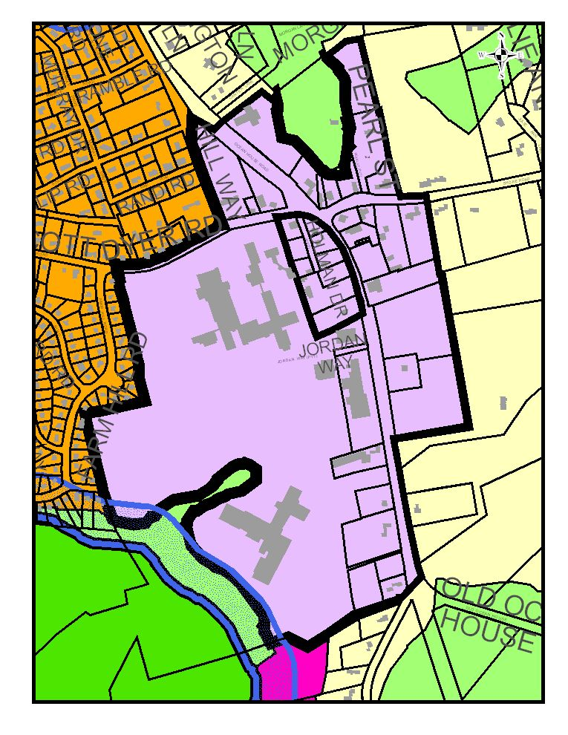
Potential TIF District
Town Center
144 Acres
1% of area
of town

Slide 8
Summary of key points
A TIF shelters new tax revenue from a set area so that the town does not need to send an arm and a leg of the new revenue to the state and to the county.
This proposal would help fund pedestrian improvements and storm water management.
This proposal is not related to any specific development.

Slide 9
Possible Next Steps
Council discussion if there should there be further exploration of a TIF district
Ask staff to develop a TIF application
Plan to have a public hearing in September

